Slide 1
Artificial Neural Network (ANN)

Slide 2
Non Symbolic Representations
Decision trees can be easily read
  A disjunction of conjunctions (logic)
  We call this a symbolic representation
Non-symbolic representations
  More numerical in nature, more difficult to read
Artificial Neural Networks (ANNs)
  A Non-symbolic representation scheme
  They embed a giant mathematical function
    To take inputs and compute an output which is interpreted as a categorisation
  Often shortened to “Neural Networks”
    Don’t confuse them with real neural networks (in heads)

Slide 3
Function Learning
Map categorisation learning to numerical problem
  Each category given a number
  Or a range of real valued numbers (e.g., 0.5 - 0.9)
Function learning examples
  Input = 1,2,3,4 Output = 1,4,9,16
  Here the concept to learn is squaring integers
  Input = [1,2,3], [2,3,4], [3,4,5], [4,5,6]
  Output = 1, 5, 11, 19
  Here the concept is: [a,b,c] -> a*c - b
    The calculation is more complicated than in the first example
Neural networks:
  Calculation is much more complicated in general
  But it is still just a numerical calculation

Slide 4
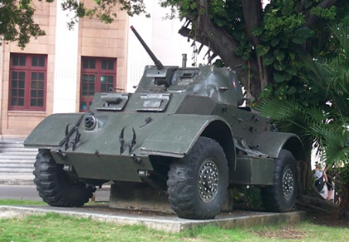
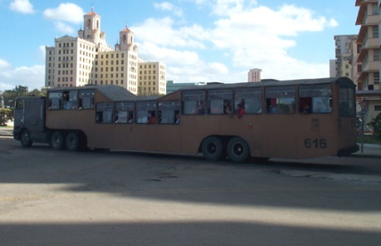


Complicated Example:
Categorising Vehicles
Input to function: pixel data from vehicle images
  Output: numbers: 1 for a car; 2 for a bus; 3 for a tank
INPUT INPUT INPUT INPUT
OUTPUT = 3 OUTPUT = 2 OUTPUT = 1 OUTPUT=1

Slide 5
So, what functions can we use?
Biological motivation:
  The brain does categorisation tasks like this easily
  The brain is made up of networks of neurons
Naturally occurring neural networks
  Each neuron is connected to many others
    Input to one neuron is the output from many others
    Neuron “fires” if a weighted sum S of inputs > threshold
Artificial neural networks
  Similar hierarchy with neurons firing
  Don’t take the analogy too far
    Human brains: 100,000,000,000 neurons
    ANNs: < 1000 usually
    ANNs are a gross simplification of real neural networks

Slide 6
General Idea
Value calculated using
all the input unit values
Choose Cat A
(largest output value)
INPUT LAYER
HIDDEN LAYERS
OUTPUT LAYER CATEGORY
1.1
2.7
7.1
1.1
Cat A
4.2
NUMBERS INPUT
0.2
3.0
Cat B
2.1
NUMBERS OUTPUT
-0.8
-1.3
-1.2
0.3
Cat C
2.7
VALUES PROPAGATE THROUGH THE NETWORK

Slide 7
Representation of Information
If ANNs can correctly identify vehicles
  They then contain some notion of “car”, “bus”, etc.
The categorisation is produced by the units (nodes)
  Exactly how the input reals are turned into outputs
But, in practice:
  Each unit does the same calculation
    But it is based on the weighted sum of inputs to the unit
  So, the weights in the weighted sum
    Is where the information is really stored
  We draw weights on to the ANN diagrams (see later)
“Black Box” representation:
  Useful knowledge about learned concept is difficult to extract

Slide 8
ANN learning problem
Given a categorisation to learn (expressed numerically)
  And training examples represented numerically
    With the correct categorisation for each example
Learn a neural network using the examples
  which produces the correct output for unseen examples
Boils down to
  (a) Choosing the correct network architecture
    Number of hidden layers, number of units, etc.
  (b) Choosing (the same) function for each unit
  (c) Training the weights between units to work correctly

Slide 9
Perceptrons
Multiple input nodes
Single output node
  Takes a weighted sum of the inputs, call this S
  Unit function calculates the output for the network
Useful to study because
  We can use perceptrons to build larger networks
Perceptrons have limited representational abilities
  We will look at concepts they can’t learn later

Slide 10
Unit Functions
Step
Function
Sigma
Function
Linear Functions
  Simply output the weighted sum
Threshold Functions
  Output low values
    Until the weighted sum gets over a threshold
    Then output high values
    Equivalent of “firing” of neurons
Step function:
  Output +1 if S > Threshold T
  Output –1 otherwise
Sigma function:
  Similar to step function but differentiable

Slide 11
Example Perceptron
Categorisation of 2x2 pixel black & white images
  Into “bright” and “dark”
Representation of this rule:
  If it contains 2, 3 or 4 white pixels, it is “bright”
  If it contains 0 or 1 white pixels, it is “dark”
Perceptron architecture:
  Four input units, one for each pixel
  One output unit: +1 for white, -1 for dark

Slide 12
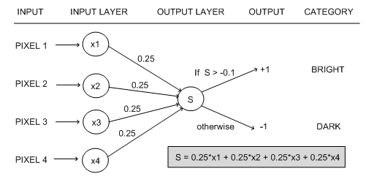

Example Perceptron
Example calculation: x₁=-1, x₂=1, x₃=1, x₄=-1
  S = 0.25*(-1) + 0.25*(1) + 0.25*(1) + 0.25*(-1) = 0
0 > -0.1, so the output from the ANN is +1
  So the image is categorised as “bright”

Slide 13
Learning in Perceptrons
Need to learn
  Both the weights between input and output units
  And the value for the threshold
Make calculations easier by
  Thinking of the threshold as a weight from a special input unit where the output from the unit is always 1
Exactly the same result
  But we only have to worry about learning weights

Slide 14
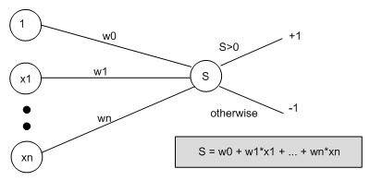
New Representation for Perceptrons
Special Input Unit
Always produces 1
Threshold function
has become this

Slide 15
Learning Algorithm
Weights are set randomly initially
For each training example E
  Calculate the observed output from the ANN, o(E)
  If the target output t(E) is different to o(E)
    Then tweak all the weights so that o(E) gets closer to t(E)
    Tweaking is done by perceptron training rule
This routine is done for every example E
Don’t necessarily stop when all examples used
  Repeat the cycle again (an ‘epoch’)
  Until the ANN produces the correct output
    For all the examples in the training set (or good enough)

Slide 16
Perceptron Training Rule
When t(E) is different to o(E)
  Add on Δ_{i} to weight w_{i}
  Where Δ_{i} = η(t(E)-o(E))x_{i}
  Do this for every weight in the network
Interpretation:
  (t(E) – o(E)) will either be +2 or –2 [cannot be the same sign]
  So we can think of the addition of Δ_{i} as the movement of the weight in a direction
    Which will improve the networks performance with respect to E
  Multiplication by xi
    Moves it more if the input is bigger

Slide 17
The Learning Rate
η is called the learning rate
  Usually set to something small (e.g., 0.1)
To control the movement of the weights
  Not to move too far for one example
  Which may over-compensate for another example
If a large movement is actually necessary for the weights to correctly categorise E
  This will occur over time with multiple epochs

Slide 18
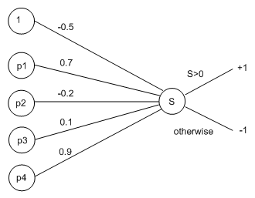
Worked Example
Return to the “bright” and “dark” example
Use a learning rate of η = 0.1
Suppose we have set random weights:

Slide 19
Worked Example
Use this training example, E, to update weights:
Here, x1 = -1, x2 = 1, x3 = 1, x4 = -1 as before
Propagate this information through the network:
  S = (-0.5 * 1) + (0.7 * -1) + (-0.2 * +1) + (0.1 * +1) + (0.9 * -1) = -2.2
Hence the network outputs o(E) = -1
But this should have been “bright”=+1
  So t(E) = +1

Slide 20
Calculating the Error Values
Δ₀ = η(t(E)-o(E))x₀
  = 0.1 * (1 - (-1)) * (1) = 0.1 * (2) = 0.2
Δ₁ = η(t(E)-o(E))x₁
  = 0.1 * (1 - (-1)) * (-1) = 0.1 * (-2) = -0.2
Δ₂ = η(t(E)-o(E))x₂
  = 0.1 * (1 - (-1)) * (1) = 0.1 * (2) = 0.2
Δ₃ = η(t(E)-o(E))x₃
  = 0.1 * (1 - (-1)) * (1) = 0.1 * (2) = 0.2
Δ₄ = η(t(E)-o(E))x₄
  = 0.1 * (1 - (-1)) * (-1) = 0.1 * (-2) = -0.2

Slide 21
Calculating the New Weights
w’₀ = -0.5 + Δ₀ = -0.5 + 0.2 = -0.3
w’₁ = 0.7 + Δ₁ = 0.7 + -0.2 = 0.5
w’₂ = -0.2 + Δ₂ = -0.2 + 0.2 = 0
w’₃= 0.1 + Δ₃ = 0.1 + 0.2 = 0.3
w’₄ = 0.9 + Δ₄ = 0.9 - 0.2 = 0.7

Slide 22
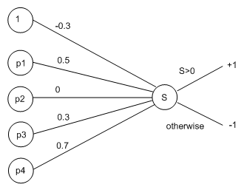
New Look Perceptron
Calculate for the example, E, again:
  S = (-0.3 * 1) + (0.5 * -1) + (0 * +1) + (0.3 * +1) + (0.7 * -1) = -1.2
Still gets the wrong categorisation
  But the value is closer to zero (from -2.2 to -1.2)
  In a few epochs time, this example will be correctly categorised

